Slide 1

Annual General Meeting of the
Mathematics Society 12-13

Slide 2
Executive Committee Members
Name | Status and Faculty | Responsibility
Mr. K.B Ching | Teacher of Room A | Teacher-in-charge
Jason Tsang | Student of 5F | President
Ian Kwan | Student of 5F | Vice-president
Kwan Chun Hin | Student of 5F | Vice-president
Yalsin Li | Student of 4F | I.T Secretary
Wayne Leung | Student of 5F | External Secretary
Terence Tsui | Student of 4F | Internal Secretary
Edward Tong | Student of 5F | Financial Secretary

Slide 3
Executive Committee Members
Name | Status and Faculty | Responsibility
Andy Cheung | Student of 4F | Math Director
Eric Cheng | Student of 4F | Math Director
None | None | None
None | None | None

Slide 4
Outline of Future Events
Activity | Date | Responsible person
Revision Class | Nov, Dec | Alvin Kwan
Tutorial Class, Special Class | Whole Year | Ian Kwan
J-S Math Hunt | Feb | Wayne Leung
Open Day | Feb | Jason Tsang
HKMO Training Class | Jan-Mar | Mr. Ching
Science Week, Math Week | Apr | Edward Tong
Pi Day | Mar | Jason Tsang

Slide 5
Math Week
Events | P.I.C | Target
Sudoku Competition | Yalsin Li | F.1-3
Rubik’s Cube Competition | Eric Cheng | F.1-4
Internal Math Hunt | Terence Tsui | F.1-4
Math Contest | Andy Cheung | F.1-4

Slide 6
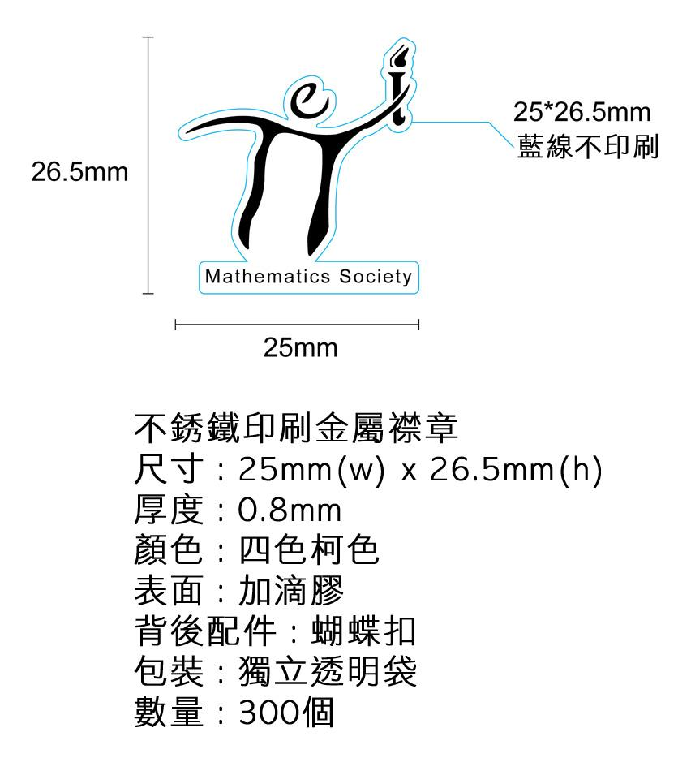
Tie Pin

Slide 7
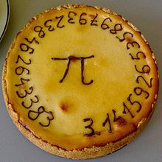
Pi Day
Organize a Teacher versus Students football match.
Order a pie (pronounced as “Pi”) and eat it during lunchtime.
A “Pi” Pie

Slide 8
Special Class
Teaching: Combinatorics, Geometry, Algebra, Number Theory
Form 2-3: Thursday Lunchtime at 2E classroom, starts at 1:15
Form 1: Tuesday Lunchtime at 2E classroom, starts at 1:15

Slide 9
Question-and-Answer Session
Methods of communication:
[1] In person:
All executive committee members are stationed in Classroom Form 5F or 4F;
[2] On the board:
Announcements and updates will be posted on the club board;
[3] On the website:
Announcements and updates will be posted on the club website (http://www.sjc.edu.hk/~mathsoc);
[4] Through Facebook:
Announcements and updates will be posted on the ClubFacebook page (http://www.facebook.com/SJCMathematicsSociety20122013?ref=ts&fref=ts).

